Slide 1
PART 2

Slide 2
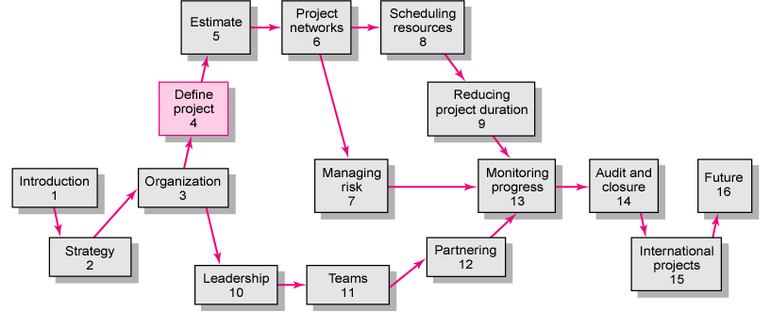
Copyright © 2006 The McGraw-Hill Companies. All rights reserved.
McGraw-Hill/Irwin 4–<number>
Notes:
PART 1:
Introduction: Concepts of PM
Strategy: How a Company’s Strategy can affect the project selection
Organization: Structure and Culture
Leadership: How to become an effective PM → Need to earns skills: teamwork, partnering
Teams: how to recruit and manage a team during 5 phases of a team development cycle.

Slide 3
CONTENTS
Defining the Project
Developing a Project Plan
Managing Risk
Reducing Project Duration
Progress and Performance Measurement and Evaluation
Project Closure
Copyright © 2006 The McGraw-Hill Companies. All rights reserved.
McGraw-Hill/Irwin 4–<number>

Slide 4
EVALUATION
Mid-term grade (50%)
Final grade (50%)
  Final Exam (70-75min) 40%
  Individual Assignment 5%
  Quiz + Participation in class 5%
Copyright © 2006 The McGraw-Hill Companies. All rights reserved.
McGraw-Hill/Irwin 4–<number>

Slide 5
Individual assignment
2000 words report (~ 6 pages)
“Reviewing the factors that infuences on the project success”
  Different perspectives
  Analysis
  Examples
  Conclusions
  References
Copyright © 2006 The McGraw-Hill Companies. All rights reserved.
McGraw-Hill/Irwin 4–<number>

